Slide 1
Figures in Chapter 4:
V1 and information coding
From “Understanding Vision: theory, models, and data”, by Li Zhaoping, Oxford University Press, 2014

Slide 2
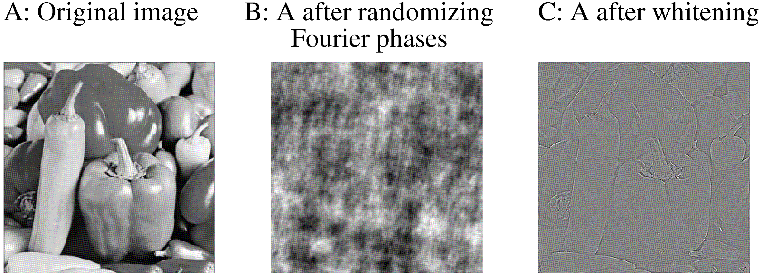

Slide 3
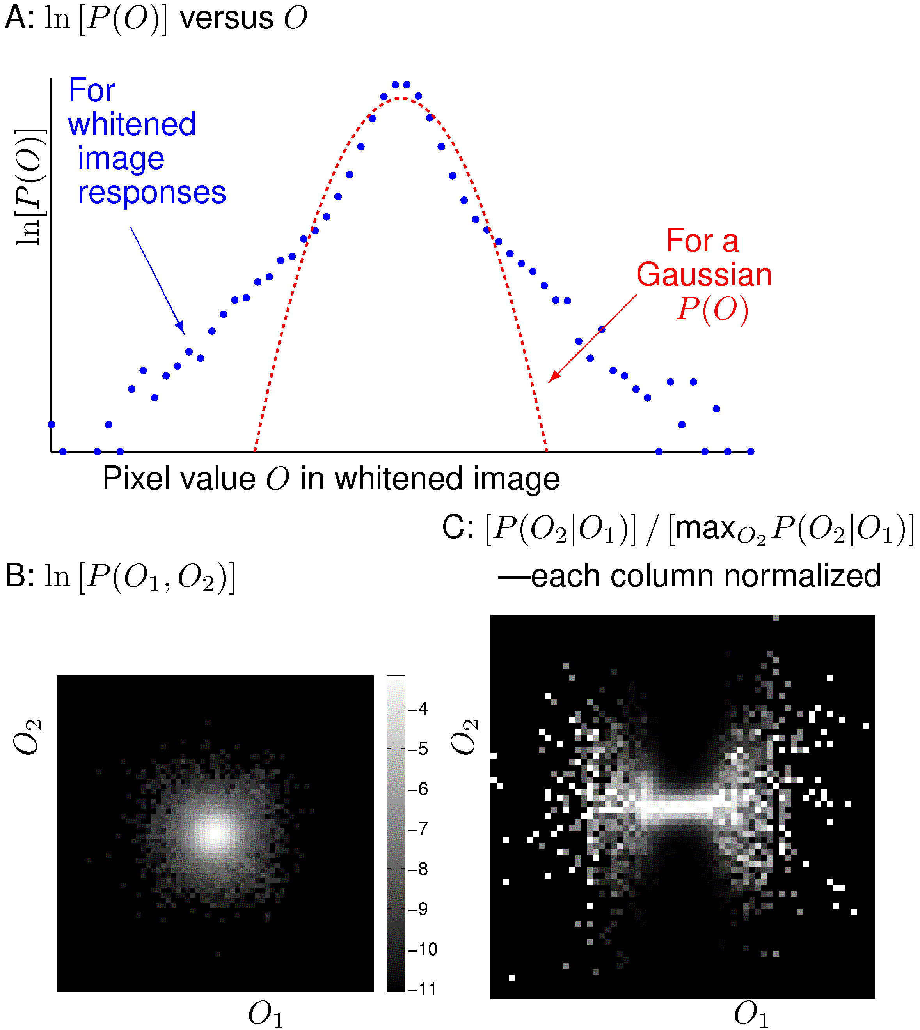

Slide 4
