Slide 1
Figures in Chapter 1: Approach and scope
From “ Understanding Vision: theory, models, and data”, by Li Zhaoping, published by Oxford University Press, 2014

Slide 2
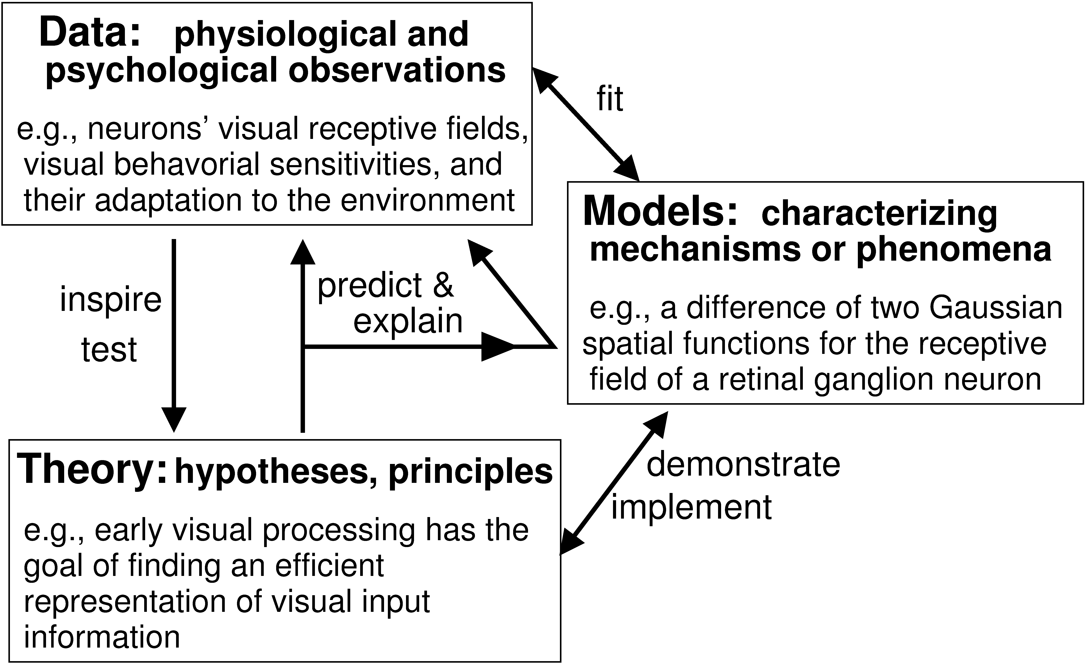

Slide 4
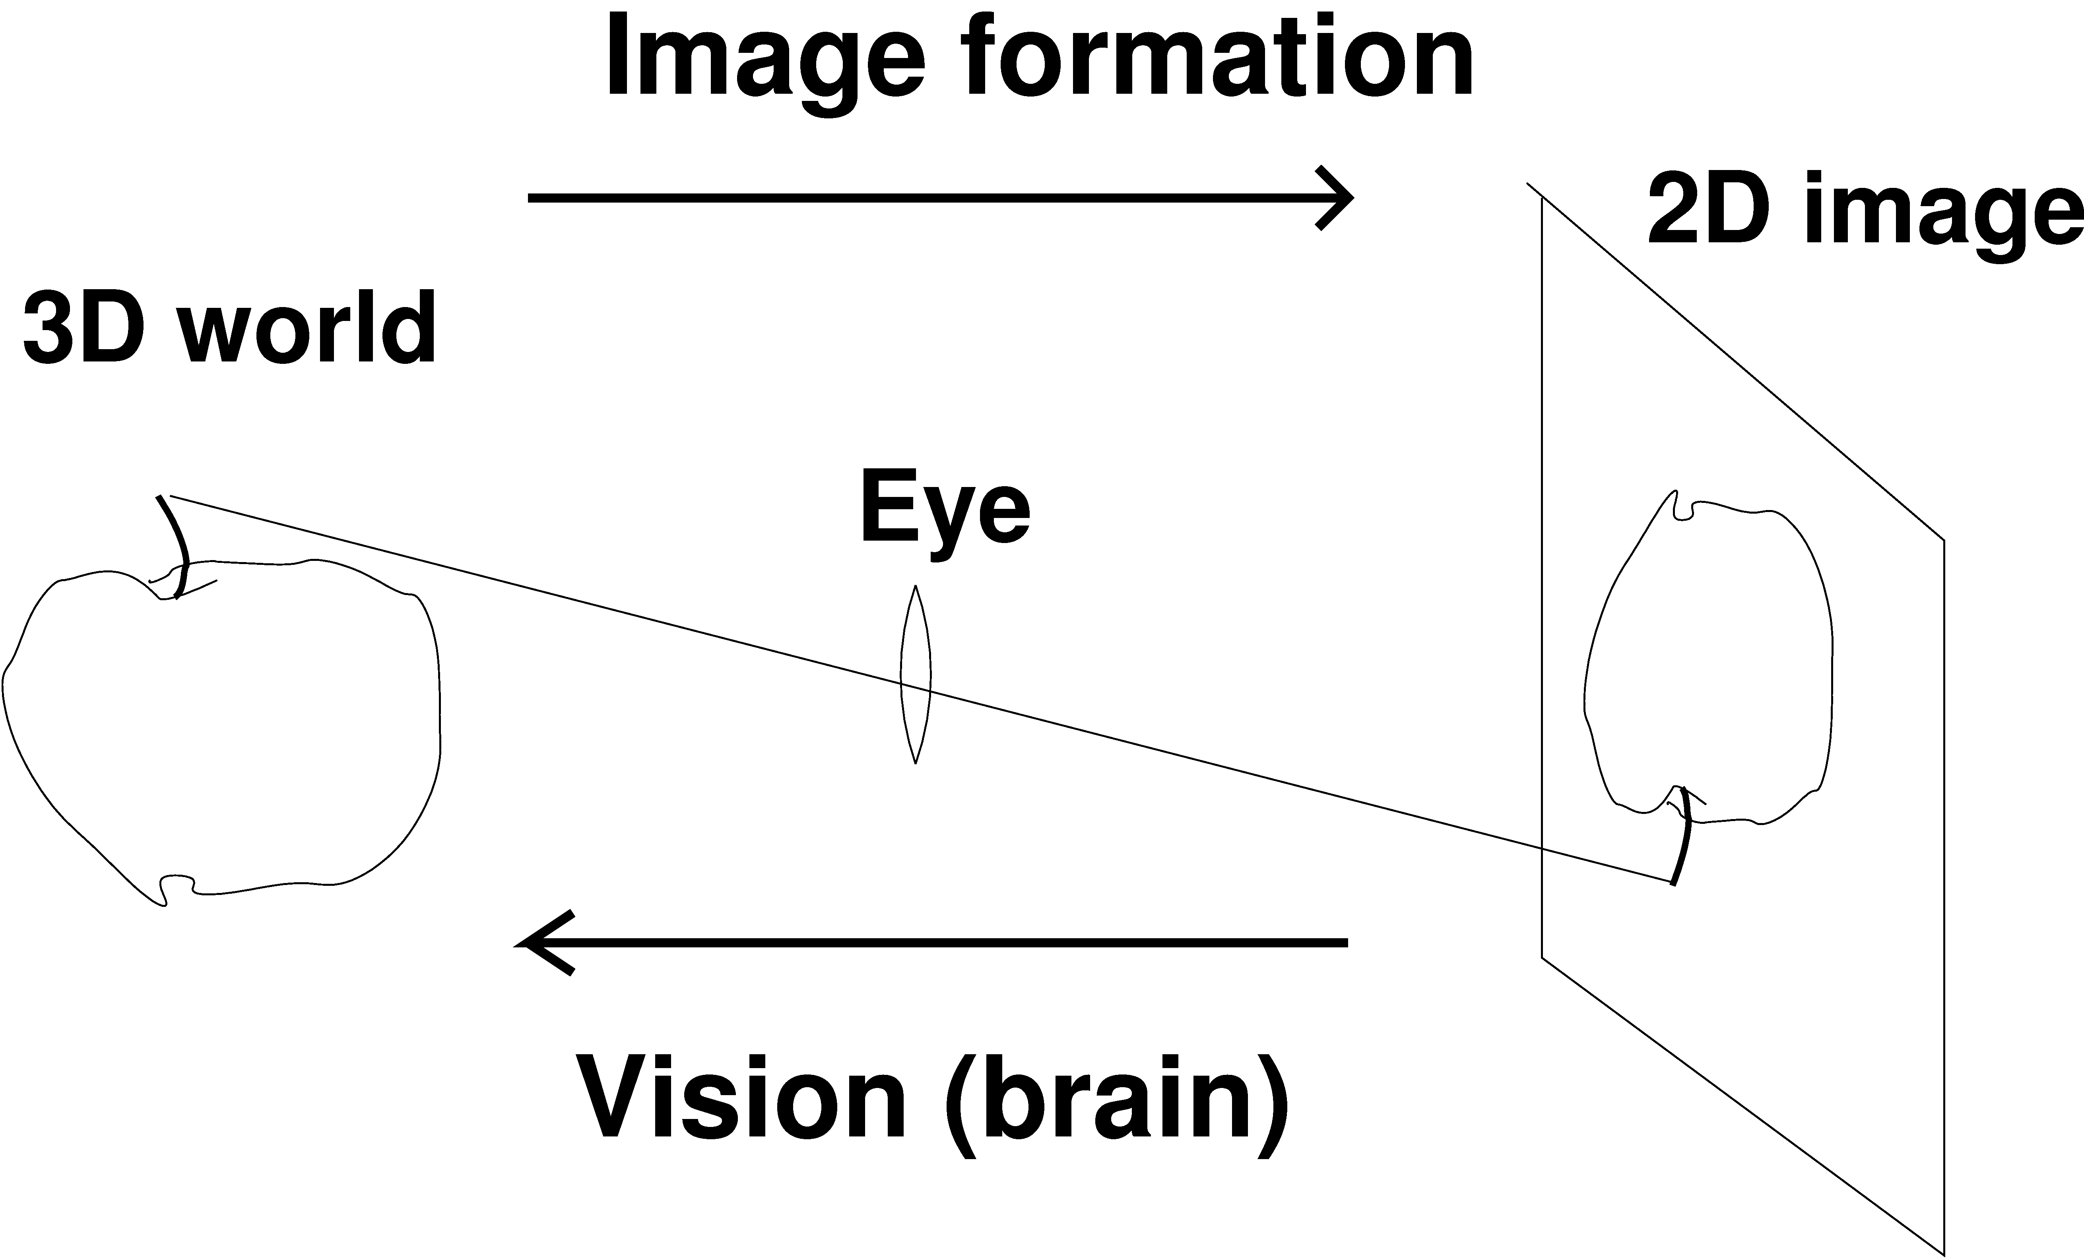

Slide 5
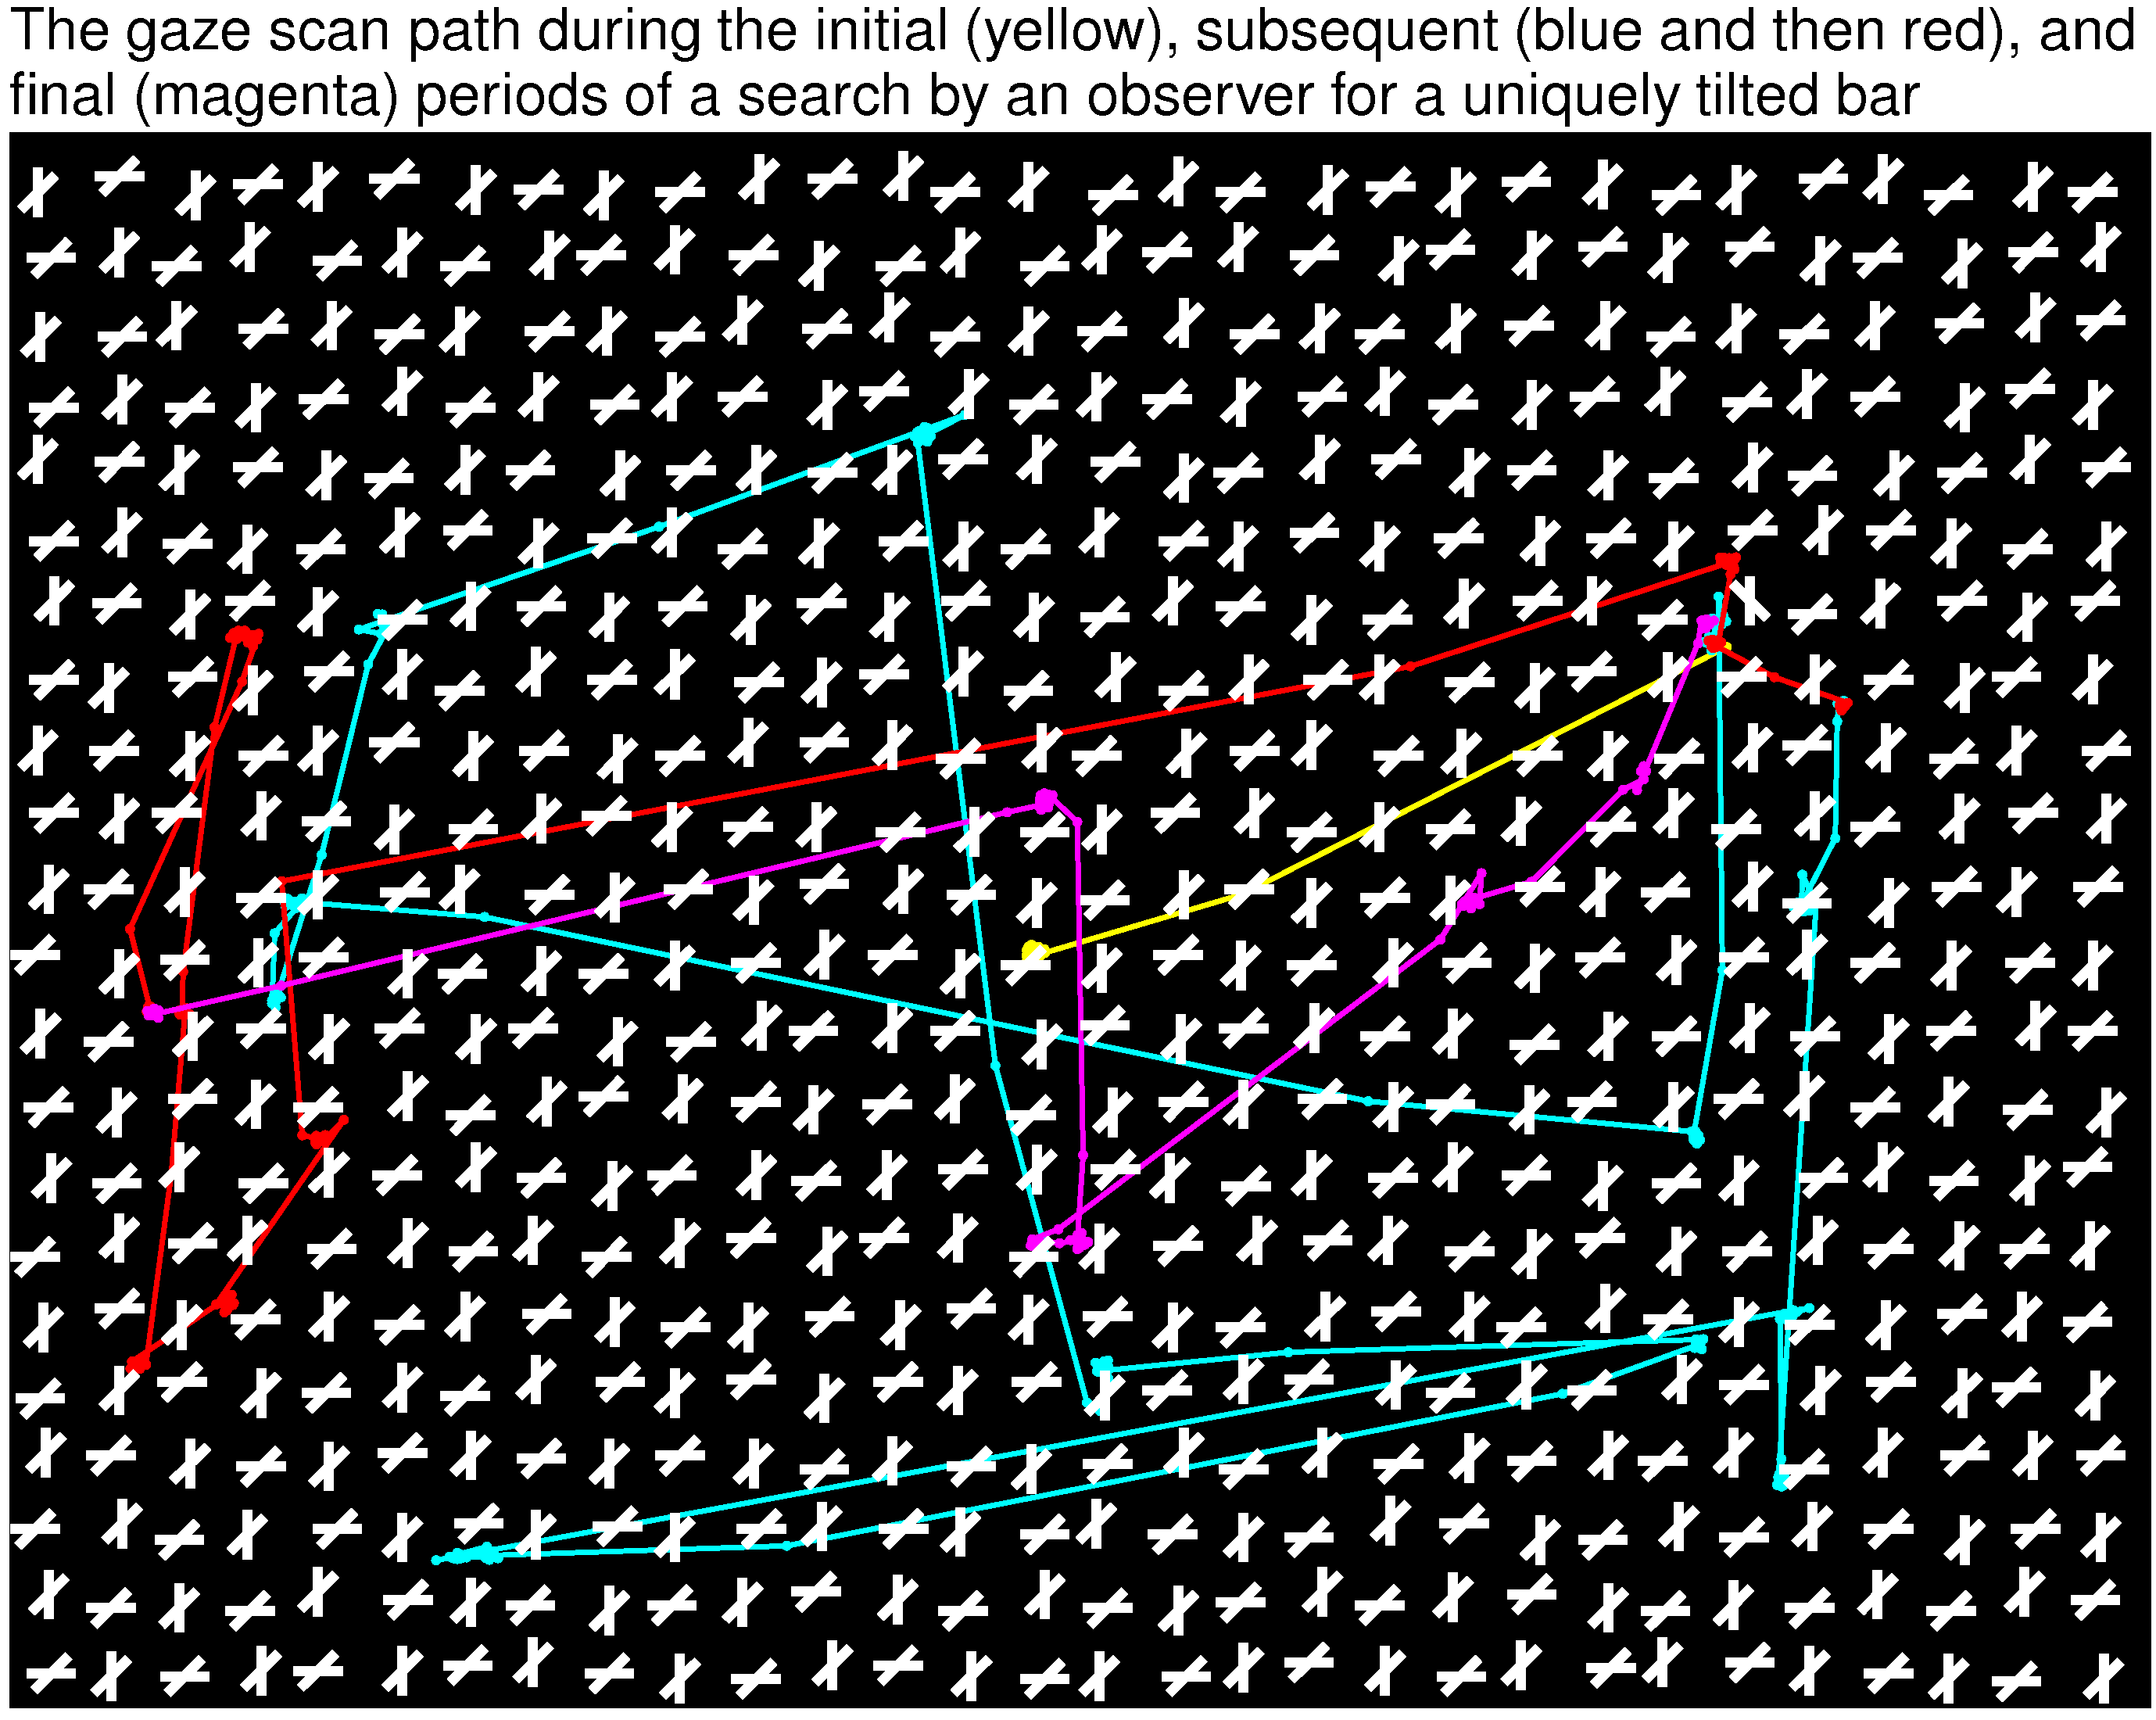

Slide 7
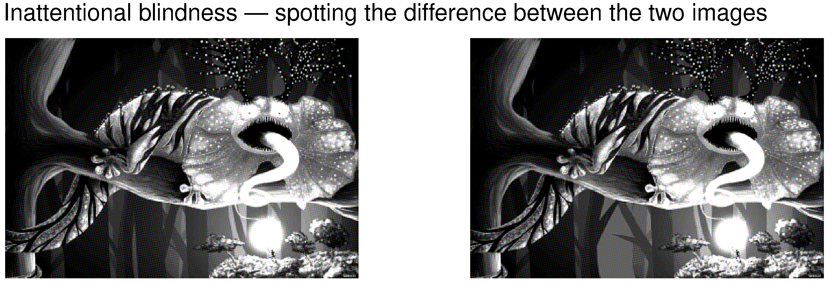

Slide 8
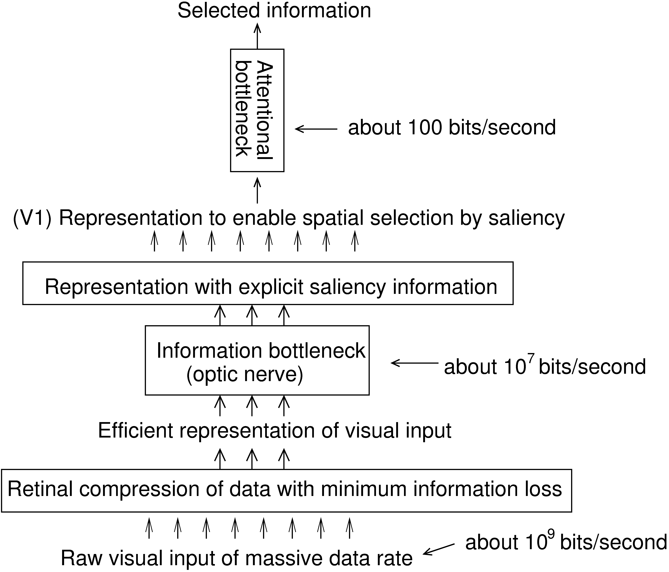

Slide 9
