Slide 1
Visual psychophysics course in Dept of Sensory and Sensorimotor Systems, MPI, Jan 7-24, 2020
Course website:
https://webdav.tuebingen.mpg.de/u/zli/VisualPsychophysicsTrainingCourse_UTuebingen_2020.html
Schedule: full day, Monday through Friday, whole day every weekday during that period
Location: Max Planck Ring 8, in the labs of department of Sensory and Sensorimotor Systems
Teaching team: Prof. Li Zhaoping (lead lecturer), Dr. Jinyou Zou, Dr. Sarah Stednitz, Dr. Jeremy Badler,
and other members of Zhaoping's department.
Preparation works for the course:
(1) Oct. 24, 2019, message to students: please prepare for the course by self-learning Matlab programming. You can use this book to learn, and you can find some online courses as well.
(2) Dec. 17, 2019, message to students: please fill out forms for the on boarding process to enter the MPI for the course
Course Plan
(1) Each student has his/her own laptop on which matlab and Psychophysics toolbox are installed.
(2) Plan for the first two weeks of the course, starting Jan. 7th:
(2a) Learn the basics of visual psychophysics by going through selected exercises from this online tutorial.
(2b) Lectures on the basics of visual psychophysics research --- rules for experimental record taking, data collection, data storage, scientific conduct for research, tips for doing daily research.
(2c) Practice and extension by trying to implement a previous experiment in this paper
Attention capture by eye of origin singletons even without awareness --- a hallmark of a bottom-up saliency map in the primary visual cortex.
Journal of Vision, 8(5):1, 1-18, http://journalofvision.org/8/5/1/, doi:10.1167/8.5.1 This will involve: reading and understanding the paper,
write matlab code to implement it, take data for one or more of the experiments in this paper.
(2d) Extensions: for students who can do 2a-c quickly, we offer more learning and practice in zebrafish visual behavior,
human eye tracking, or even a mini-project which could be research-worthy, depending on the progress of individual students on the course.
(3) Plan for the third week of the course: each student analyzes data, then prepares and
gives a presentation of the results from the data collected, as well as the lessons learned from the course.

Slide 2
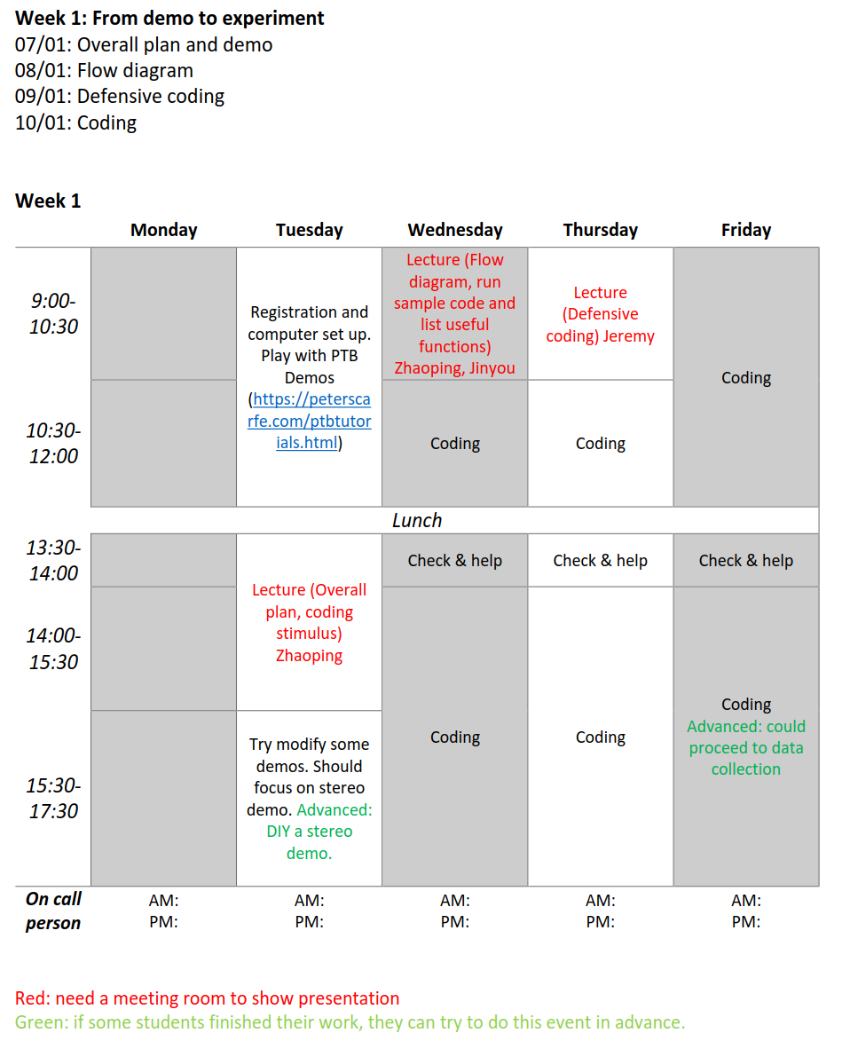
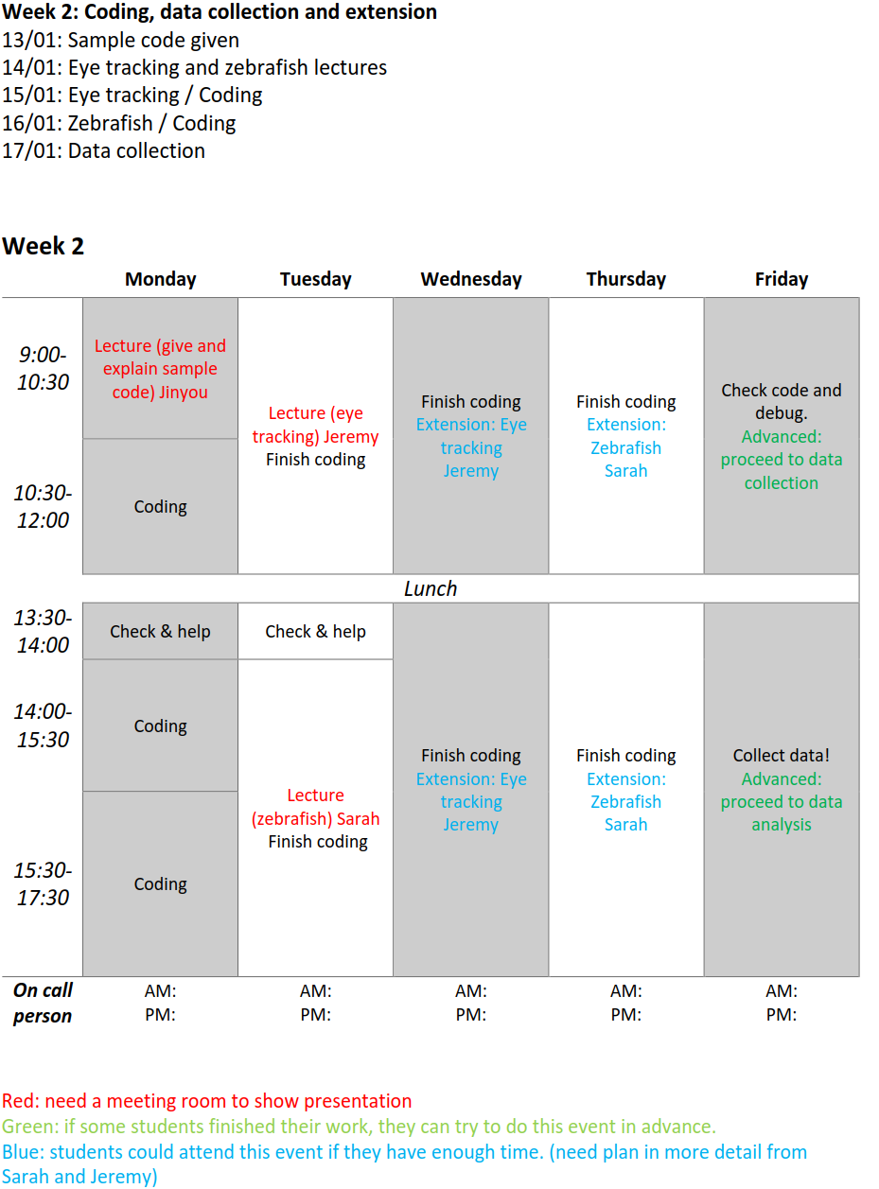
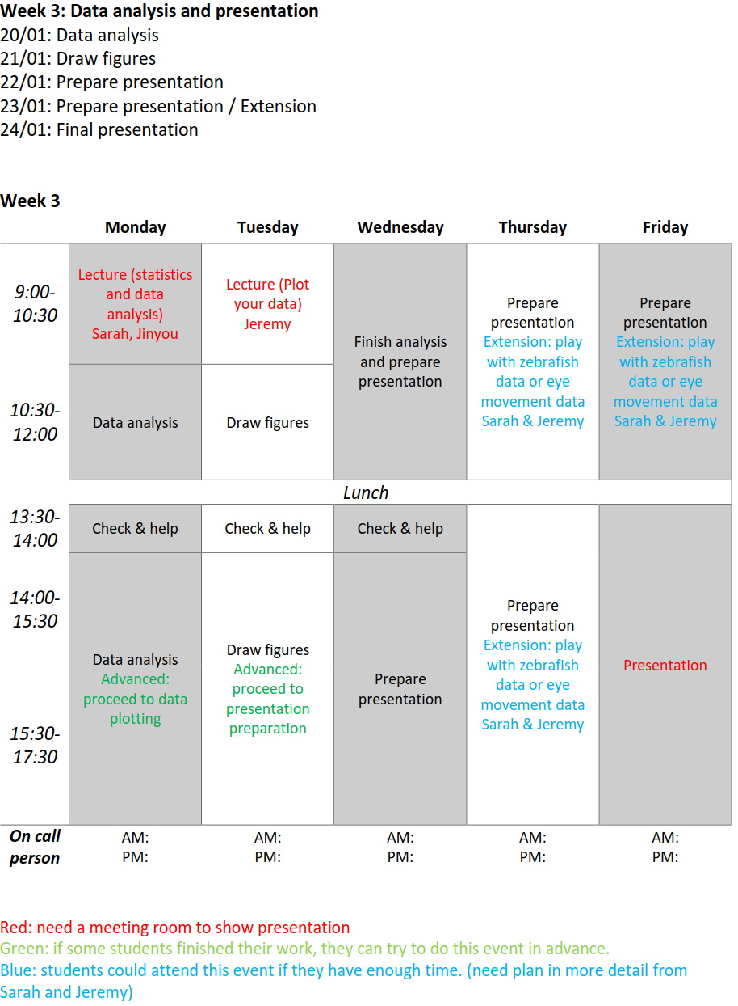

Slide 3
Week 1: From demo to experiment
07/01: Overall plan and demo
08/01: Flow diagram
09/01: Defensive coding
10/01: Coding
Week 1
Red: need a meeting room to show presentation
Green: if some students finished their work, they can try to do this event in advance.
 | Monday | Tuesday | Wednesday | Thursday | Friday
9:00-10:30 |  | Registration and computer set up. Play with PTB Demos (https://peterscarfe.com/ptbtutorials.html) | Lecture (Flow diagram, run sample code and list useful functions) Zhaoping, Jinyou | Coding Advanced: Zhaoping’s presentation on visual illusion | Coding
10:30-12:00 |  |  | Coding | Lecture (Defensive coding) Jeremy
Lunch
13:30-14:00 |  | Lecture (Overall plan, coding stimulus) Zhaoping | Check & help | Check & help | Check & help
14:00-15:30 |  |  | Coding | Coding | Coding Advanced: could proceed to data collection
15:30-17:30 |  | Try modify some demos. Should focus on stereo demo. Advanced: DIY a stereo demo.
On call person |  | AM: JINYOU PM: JINYOU | AM: JEREMY PM: JEREMY | AM: JINYOU PM: JINYOU | AM: JEREMY PM: JEREMY

Slide 4
Week 2: Coding, data collection and extension
13/01: Sample code given
14/01: Eye tracking and zebrafish lectures
15/01: Eye tracking / Coding
16/01: Zebrafish / Coding
17/01: Data collection
Week 2
Red: need a meeting room to show presentation
Green: if some students finished their work, they can try to do this event in advance.
Blue: students could attend this event if they have enough time. (need plan in more detail from Sarah and Jeremy)
 | Monday | Tuesday | Wednesday | Thursday | Friday
9:00-10:30 | Lecture (give and explain sample code) Jinyou | Lecture (eye tracking) Jeremy Finish coding | Finish coding Extension: Eye tracking Jeremy | Finish coding Extension: Zebrafish Sarah | Check code and debug. Advanced: proceed to data collection
10:30-12:00 | Coding
Lunch
13:30-14:00 | Check & help | Check & help | Finish coding Extension: Eye tracking Jeremy | Finish coding Extension: Zebrafish Sarah | Collect data! Advanced: proceed to data analysis
14:00-15:30 | Coding | Lecture (zebrafish) Sarah Finish coding
15:30-17:30 | Coding
On call person | AM: JINYOU PM: JINYOU | AM: JEREMY PM: SARAH | AM: SARAH PM: SARAH | AM: JEREMY PM: JEREMY | AM: JINYOU PM: JINYOU

Slide 5
Week 3: Data analysis and presentation
20/01: Data analysis
21/01: Draw figures
22/01: Prepare presentation
23/01: Prepare presentation / Extension
24/01: Final presentation
Week 3
Red: need a meeting room to show presentation
Green: if some students finished their work, they can try to do this event in advance.
Blue: students could attend this event if they have enough time. (need plan in more detail from Sarah and Jeremy)
 | Monday | Tuesday | Wednesday | Thursday | Friday
9:00-10:30 | Lecture (statistics and data analysis) Sarah, Jinyou | Lecture (Plot your data) Jeremy | Finish analysis and prepare presentation | Prepare presentation Extension: play with zebrafish data or eye movement data Sarah & Jeremy | Prepare presentation Extension: play with zebrafish data or eye movement data Sarah & Jeremy
10:30-12:00 | Data analysis | Draw figures
Lunch
13:30-14:00 | Check & help | Check & help | Check & help | Prepare presentation Extension: play with zebrafish data or eye movement data Sarah & Jeremy | Presentation
14:00-15:30 | Data analysis Advanced: proceed to data plotting | Draw figures Advanced: proceed to presentation preparation | Prepare presentation
15:30-17:30
On call person | AM: SARAH PM: SARAH | AM: JEREMY PM: JEREMY | AM: JINYOU PM: JINYOU | AM: JINYOU PM: JINYOU | AM: JINYOU PM: JEREMY

Slide 6
Organization:
Lectures are in the lecture room, coding/experiments in the lab/office
Team and individual works: Students team up : two students per team. Team members help each other in coding, reading, discussion etc, but each student should complete his/her own code.
Teaching staff whereabouts: at least one teacher is around in his/her office nearby at any time during the course, students can always approach a teacher (or a dept member) to ask questions or ask for help anytime, e.g., for a coding problem
Lunch: students and teaching staff (at least one) have lunch together for communication, e.g., 1 pm each day for lunch.
Daily verbal report/discussion of progress/issues/ problems from each student:
Each day, speak with a teaching staff for at least 5 minutes, or as long as needed, about how you are doing, so that we can provide timely feedback, advice, and help. This can be done at lunch or break time, or at the end of the each day.

Slide 7
Learning by doing: implement a previous experiment
(1) Read the paper --- practice literature reading, understanding the purpose, design, stimulus, subject task, data to be collected, etc
(2) Do matlab coding for the experiment --- practice coding, flow diagram of the code, coding subroutines, functions, how to display a stimulus, how to give instructions, how to collect subject responses, how to format and save data, code debugging, how to code defensively to avoid errors, how to code to make experimental design changes easily, etc
(3) Data collection --- practice data collection, practice giving instructions, continue debugging, plot out raw data to check that all desired information are collected, watch out for experimental confounds, etc
(4) Data analysis --- practice data analysis, calculate statistical results such as mean and accuracy of subject responses across trials, accuracy and reaction times of subjects. Plot out results in multiple ways to examine data.
(5) Presentation --- practice scientific presentation, writing, and reporting, and reflect on lessons learned, discuss results and future extensions.

Slide 8

The previous experiment to implement in this course:

Slide 9
Abstract:
Red: findings in brief; Blue: stimuli and task; Purple: Results from data; Green: interpretation
Human observers are typically unaware of the eye of origin of visual inputs. This study shows that an eye of origin or
ocular singleton, e.g., an item in the left eye among background items in the right eye, can nevertheless attract attention
automatically. Observers searched for a uniquely oriented bar, i.e., an orientation singleton, in a background of horizontal
bars. Their reports of the tilt direction of the search target in a brief (200 ms) display were more accurate in a dichoptic
congruent (DC) condition, when the target was also an ocular singleton, than in a monocular (M) condition, when all bars
were presented to the same single eye, or a dichoptic incongruent (DI) condition, when an ocular singleton was a
background bar. The better performance in DC did not depend on the ability of the observers to report the presence of
an ocular singleton by making forced choices in the same stimuli (though without the orientation singleton). This
suggests that the ocular singleton exogenously cued attention to its location, facilitating the identiﬁcation of the tilt
singleton in the DC condition. When the search display persisted without being masked, observers’ reaction times (RTs)
for reporting the location of the search target were shorter in the DC, and longer in the DI, than the M condition,
regardless of whether the observers were aware that different conditions existed. In an analogous design, similar RT
patterns were observed for the task of ﬁnding an orientation contrast texture border. These results suggest that in typical
trials, attention was more quickly attracted to or initially distracted from the target in the DC or DI condition, respectively.
Hence, an ocular singleton, though elusive to awareness, can effectively compete for attention with an orientation
singleton (tilted 20 or 50 degrees from background bars in the current study). Similarly, it can also make a difﬁcult visual
search easier by diminishing the set size effect. Since monocular neurons with the eye of origin information are abundant
in the primary visual cortex (V1) and scarce in other cortical areas, and since visual awareness is believed to be absent
or weaker in V1 than in other cortical areas, our results provide a hallmark of the role of V1 in creating a bottom-up
saliency map to guide attentional selection.

Slide 10
Science and motivation behind the experiments:
(1) A theory about visual attention and its neural basis
(2) Why these experiments can test the theory?

Slide 11
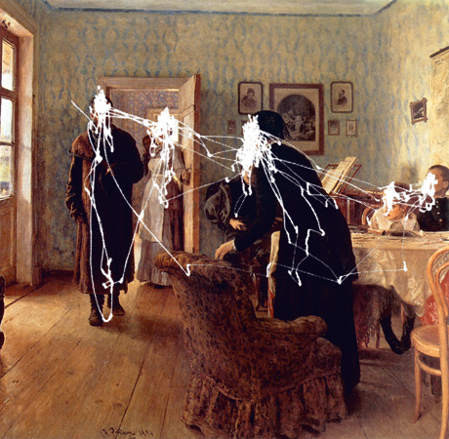
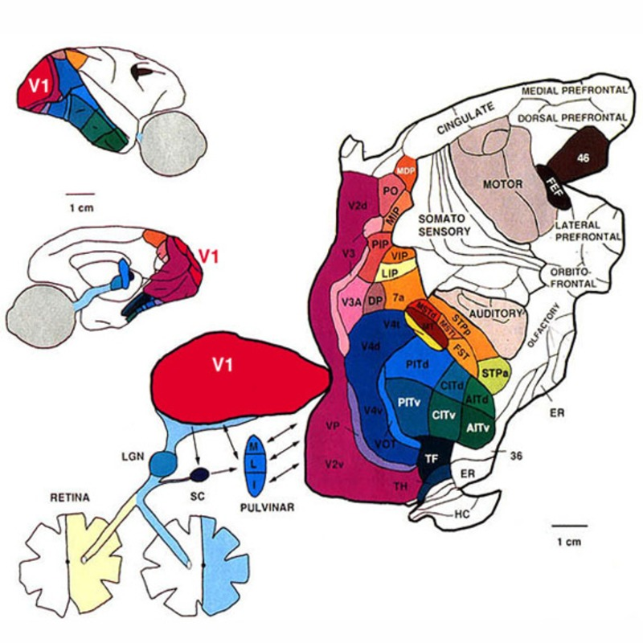
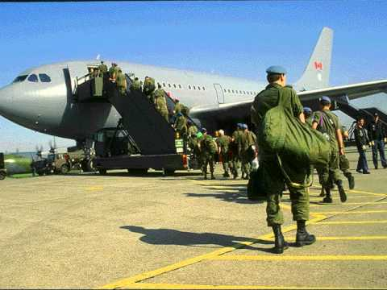

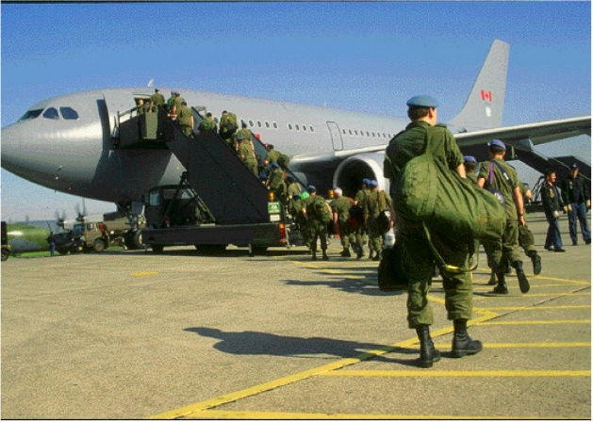

Vision: Looking (attentional selection) and seeing
40 bits/second
Perception,
Action,
Decision,
memory
Visual
input
Encoding
Selection
Decoding
20 frames,
20 MB/second
e.g., face
recognition
e.g., efficient
coding in retina
Looking
Seeing
We are nearly blind!
}

Slide 12
Visual attentional selection:
top-down vs. bottom-up selection
Task: find a uniquely oriented bar
Notes:
However, our attentional bottleneck is much smaller,
We can read only about 2 sentences per second …
Attention has to select these 2 sentences from a whole book of sentences,
Most sentences are deleted before they are read!!! (button to the next slide)

Slide 13
Visual attentional selection:
Retina inputs
Saliency map
to guide gaze
which brain area?
Frontal? Parietal?
top-down vs. bottom-up selection
Task: find a uniquely oriented bar
Notes:
However, our attentional bottleneck is much smaller,
We can read only about 2 sentences per second …
Attention has to select these 2 sentences from a whole book of sentences,
Most sentences are deleted before they are read!!! (button to the next slide)

Slide 14
Visual attentional selection:
Saliency regardless of visual features
Retina inputs
Saliency map
Koch & Ullman 1985, Itti & Koch 2001, etc
which brain area?
Frontal? Parietal?
top-down vs. bottom-up selection
Task: find a uniquely oriented bar
Notes:
However, our attentional bottleneck is much smaller,
We can read only about 2 sentences per second …
Attention has to select these 2 sentences from a whole book of sentences,
Most sentences are deleted before they are read!!! (button to the next slide)

Slide 15
The theory ---- The V1 Saliency Hypothesis (V1SH):
A bottom-up saliency map in the primary visual cortex (Li 1999, 2002)
Retina inputs
Saliency map
V1 firing rates (highest at each location)
Winner-take-all
Superior colliculus
=
Notes:
I propose that this saliency map is the map of V1 neural firing rates.
In particular, the highest response to each visual location represents the saliency of this location.
(button) This map is read perhaps by the superior colliculus, which receives mono-synaptic inputs from V1, and directs eye movements.
(button to continue)

Slide 16
The theory ---- The V1 Saliency Hypothesis (V1SH):
A bottom-up saliency map in the primary visual cortex (Li 1999, 2002)
Retina inputs
V1 firing rates (highest at each location)
Winner-take-all
Superior colliculus
Notes:
I propose that this saliency map is the map of V1 neural firing rates.
In particular, the highest response to each visual location represents the saliency of this location.
(button) This map is read perhaps by the superior colliculus, which receives mono-synaptic inputs from V1, and directs eye movements.
(button to continue)

Slide 17
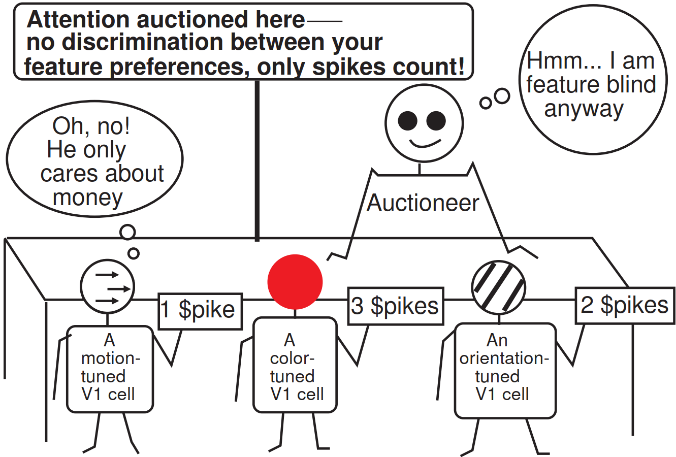
The theory ---- The V1 Saliency Hypothesis (V1SH):
A bottom-up saliency map in the primary visual cortex (Li 1999, 2002)
Neural activities as universal currency to bid for visual selection.
Retina inputs
V1 firing rates (highest at each location)
Winner-take-all
Superior colliculus
Notes:
I propose that this saliency map is the map of V1 neural firing rates.
In particular, the highest response to each visual location represents the saliency of this location.
(button) This map is read perhaps by the superior colliculus, which receives mono-synaptic inputs from V1, and directs eye movements.
(button to continue)

Slide 18
The theory ---- The V1 Saliency Hypothesis (V1SH):
A bottom-up saliency map in the primary visual cortex (Li 1999, 2002)
Retina inputs
V1
V1 firing rates (highest at each location)
Winner-take-all
Superior colliculus
Bosking et al 1997
iso-feature suppression (Blakemore & Tobin 1972, Gilbert & Wiesel 1983, Rockland & Lund 1983, Allman et al 1985, Hirsch & Gilbert 1991, Li & Li 1994, etc)
Notes:
I propose that this saliency map is the map of V1 neural firing rates.
In particular, the highest response to each visual location represents the saliency of this location.
(button) This map is read perhaps by the superior colliculus, which receives mono-synaptic inputs from V1, and directs eye movements.
(button to continue)

Slide 19
The theory ---- The V1 Saliency Hypothesis (V1SH):
A bottom-up saliency map in the primary visual cortex (Li 1999, 2002)
Retina inputs
V1
V1 firing rates (highest at each location)
Winner-take-all
Superior colliculus
Bosking et al 1997
iso-feature suppression (Blakemore & Tobin 1972, Gilbert & Wiesel 1983, Rockland & Lund 1983, Allman et al 1985, Hirsch & Gilbert 1991, Li & Li 1994, etc)
Notes:
I propose that this saliency map is the map of V1 neural firing rates.
In particular, the highest response to each visual location represents the saliency of this location.
(button) This map is read perhaps by the superior colliculus, which receives mono-synaptic inputs from V1, and directs eye movements.
(button to continue)

Slide 20
The theory ---- The V1 Saliency Hypothesis (V1SH):
A bottom-up saliency map in the primary visual cortex (Li 1999, 2002)
Retina inputs
V1
V1 firing rates (highest at each location)
Winner-take-all
Superior colliculus
Iso-orientation suppression
Bosking et al 1997
Bosking et al 1997
iso-feature suppression (Blakemore & Tobin 1972, Gilbert & Wiesel 1983, Rockland & Lund 1983, Allman et al 1985, Hirsch & Gilbert 1991, Li & Li 1994, etc
Wachtler et al 2003
Jones et al 2001 )
Iso-color
suppression
Iso-motion (direction)
suppression
Notes:
I propose that this saliency map is the map of V1 neural firing rates.
In particular, the highest response to each visual location represents the saliency of this location.
(button) This map is read perhaps by the superior colliculus, which receives mono-synaptic inputs from V1, and directs eye movements.
(button to continue)

Slide 21
The theory ---- The V1 Saliency Hypothesis (V1SH):
A bottom-up saliency map in the primary visual cortex (Li 1999, 2002)
Retina inputs
V1
V1 firing rates (highest at each location)
Winner-take-all
Superior colliculus
Left eye image
Right eye image
Bosking et al 1997
A surprising prediction:
an invisible feature attract attention!
(Zhaoping 2008, 2012)
Escapes
iso-orientation
suppression
Fused perception
Escapes
iso-eye-of-origin
suppression
Looking without seeing!
Replicated by multiple research groups since!
A fingerprint of V1
Notes:
I propose that this saliency map is the map of V1 neural firing rates.
In particular, the highest response to each visual location represents the saliency of this location.
(button) This map is read perhaps by the superior colliculus, which receives mono-synaptic inputs from V1, and directs eye movements.
(button to continue)

Slide 22
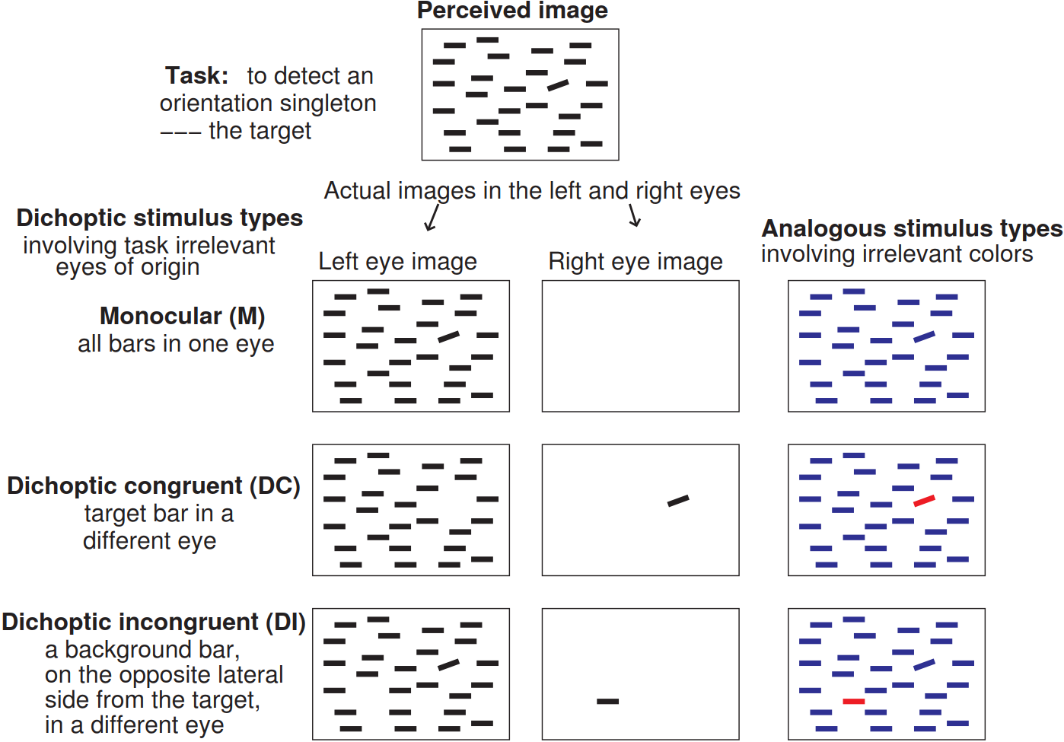
Stimuli in Experiment 1A

Slide 23
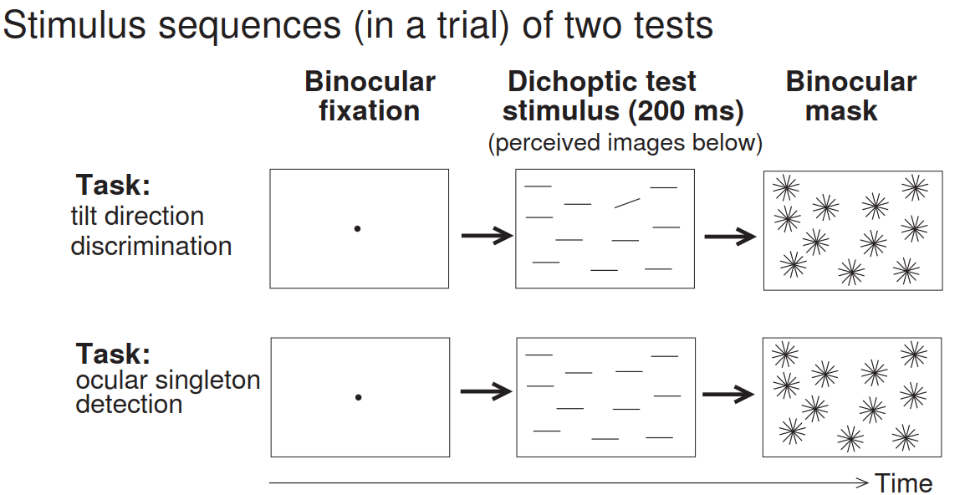
Tasks in Experiment 1
Note similarity and differences between stimuli in different experiments and conditions for planning your matlab code
Exp 1A
Exp 1B

Slide 24
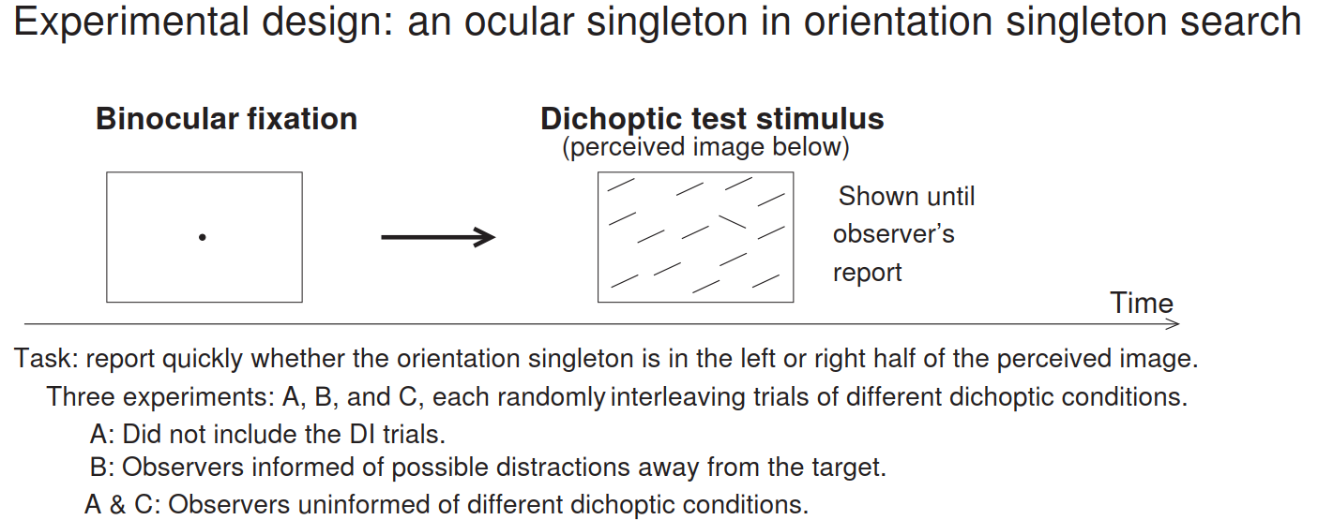
Stimuli and Tasks in Experiment 2-4 (in visual search)
Note similarity and differences between stimuli in different experiments and conditions for planning your matlab code

Slide 25
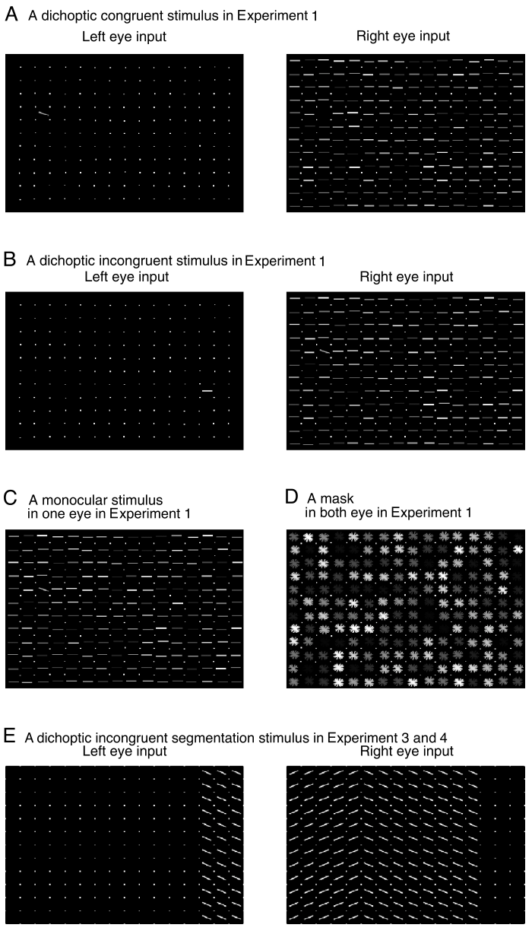
Actual stimuli are bright on black background
You need to implement at least one of the experiments, e.g., just Exp. 1A, or implement multiple experiments.
For texture segmentation task in Exp. 2-4.
Ignore this one for this course.

Slide 26
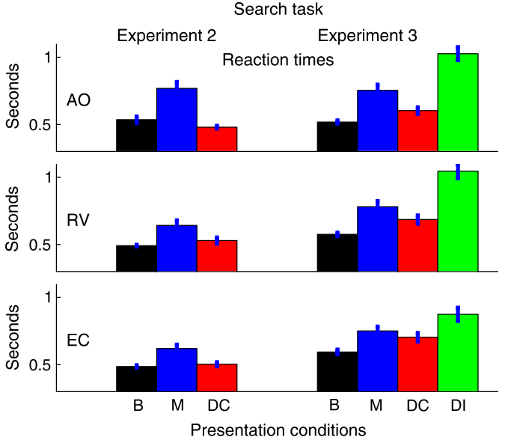
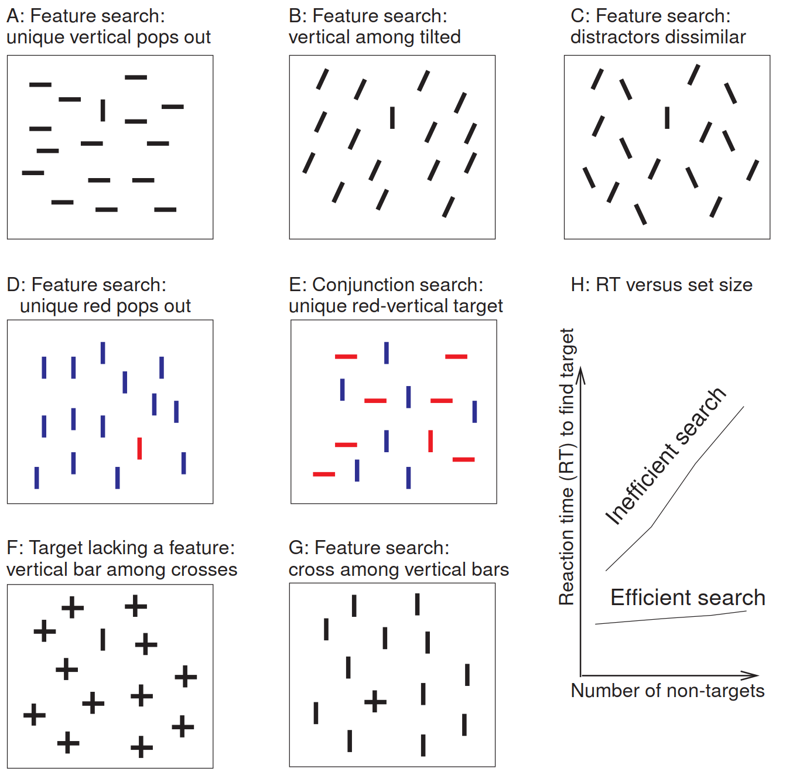
Two ways to measure visual attentional selection behaviourally: reaction times (RT) and cueing effects
RT in visual search tasks:
Left eye image
Right eye image
Fused perception
RT for monocular (M) condition versus RT for dichoptic incongruent (DI) condition

Slide 27
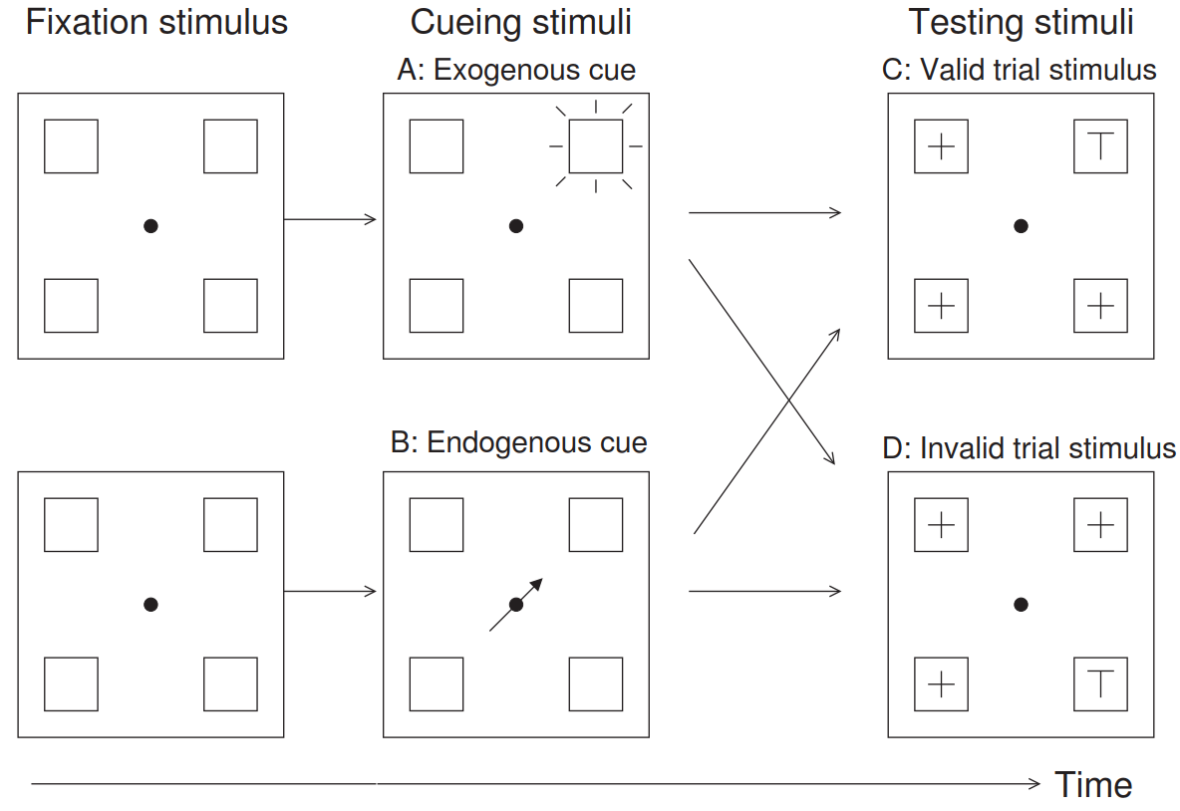
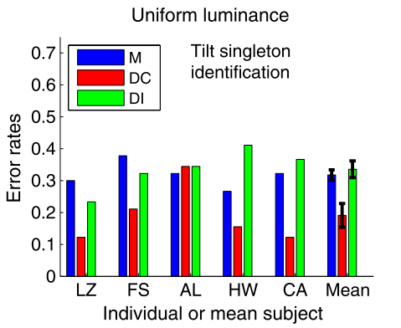
Two ways to measure visual attentional selection behaviourally: reaction times (RT) and cueing effects
Cueing effects in visual discrimination task
= improvement in performance accuracy between valid and invalid cueing
uncued
Valid cueing
invalid cueing

